Slide 1


Expectation and Perceived Time
Omer F. Yildiran

Slide 2


Slide 3
Time is a flat circle. Everything we have done or will do we will do over and over and over again—forever. - Rust Cohle (True Detective)
Notes:
I want to start the presentation with a quote from True Detective series
“
Time is a flat circle. Everything we have done or will do we will do over and over and over again—forever.
- Rust Cohle (True Detective)
Although its a pessimistic philosophical saying when we think about our experiment it is true in a funny way

Slide 5
How do we study time perception?
Duration (How long?)
Moment (When?)
Retrospective Timing
Prospective Timing
Notes:
There are lots of philosophical theories about time, the anticipation of the future, and relativity, but as cognitive scientists, we question
HOW DO WE STUDY TIME PERCEPTION?
In time we have three main variables:
First one is Duration ( in which asks how long an event has occurred?)
Then the other is temporal order of events
And relatedly The moment when event occured
Both of these variables also have 2 main component:
Retrospective timing (as considering the events started in past and ended in past or now)
Prospective timing (as events started in the future)

Slide 6
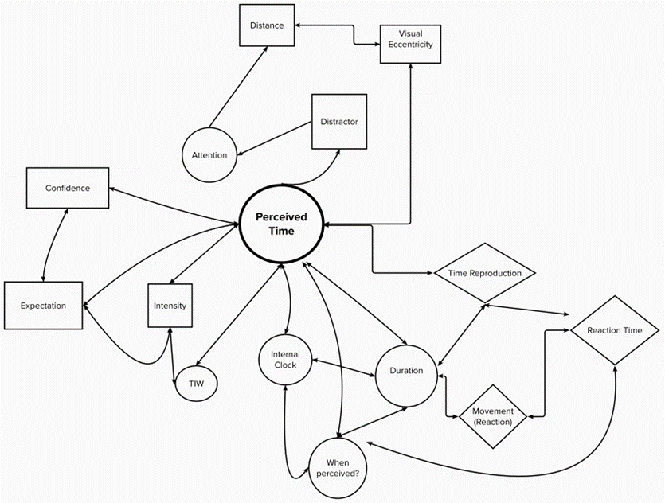
Notes:
However, time perception is not a straightforward process but rather malleable to various factors and subjective in nature.
When studying time we also need to consider about,
Attention
Confidence
Emotion
And Expectation

Slide 7
Methods to gather data
Verbal Estimation
Reproduction
An experimenter presents a target interval with a continuous sound or flash, for instance, and a participant reproduces the length of the interval by some operation.
Production
The production usually involves two-finger “taps” marking the beginning and end of the interval or pushing a button for a duration that is judged equivalent to the target interval.
Method of comparison
Whether the second interval was shorter or longer than the first.
Two-alternative forced choice (2AFC) condition
Roving
Standard varies
Reminder
Standard is same

Slide 8
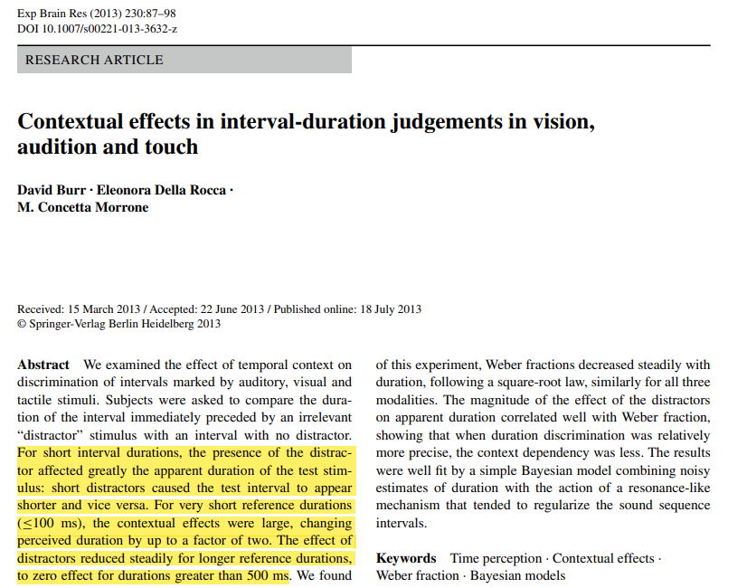
Interferance effect and attentional resources on duration
Dual-task conditions
Short distractors caused the test interval to appear shorter
Longer distractors had the opposite effect.
Process of assimilation
Effects are high in short interval
Notes:
Previous studies on duration perception found that there is an interference effect of multiple events on time perception.
Under dual-task conditions time judgements become shorter, more variable, and/or more inaccurate.
A study by Burr, Rocca and Morrone (2013) found that the presence of a distractor event can significantly alter the perceived duration of a test stimulus. In their experiment, participants were asked to judge the duration of a test interval that was presented between two distractor intervals. The researchers found that short distractors caused the test interval to appear shorter, while longer distractors had the opposite effect.
- It is sometimes defined as process of assimilation
Which tends to make two intevals (distractor and test) perceived similar
Effects are high in short interval, under 500ms

Slide 9
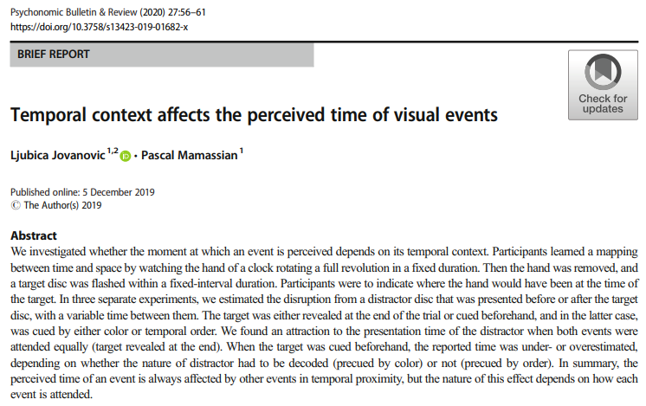
Simillar effect on the perceived moment
Earlier distractors caused the target to appear earlier
Later distractors caused to later perception of the target event
This effect was consistent when the target was unknown
However when the target color is known effect has changed
Notes:
A simillar effect was observed on the perceived moment of events. The study of Jovanovic and Mamassian aimed to expand temporal effects on duration perception by examining the impact on the moment at which an event is perceived

Slide 10
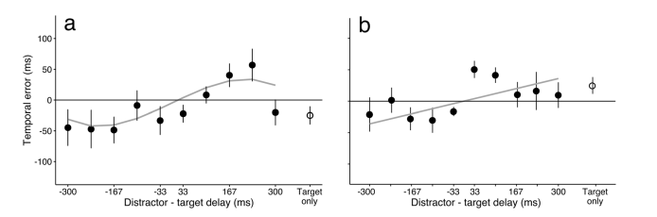
Simillar effect on the perceived moment
Earlier distractors caused the target to appear earlier
Later distractors caused to later perception of the target event
This effect was consistent when the target was unknown
However when the target color is known effect has changed
Notes:
The study revealed that the perceived time of an event is consistently influenced by other events that occur in close temporal proximity.

Slide 11
Expectation and Perceived Time of Events in the Presence of Distractor
Added expectation factor
Measured perceived time of
Expected
Reaction time differences
Unexpected
Changed ratio of target/distractor color
Notes:
Drawing upon these findings our study adds expectation factor to Jovanovic’s study and aims to investigate how do we perceive the moment of an expected and unexpected event.

Slide 12
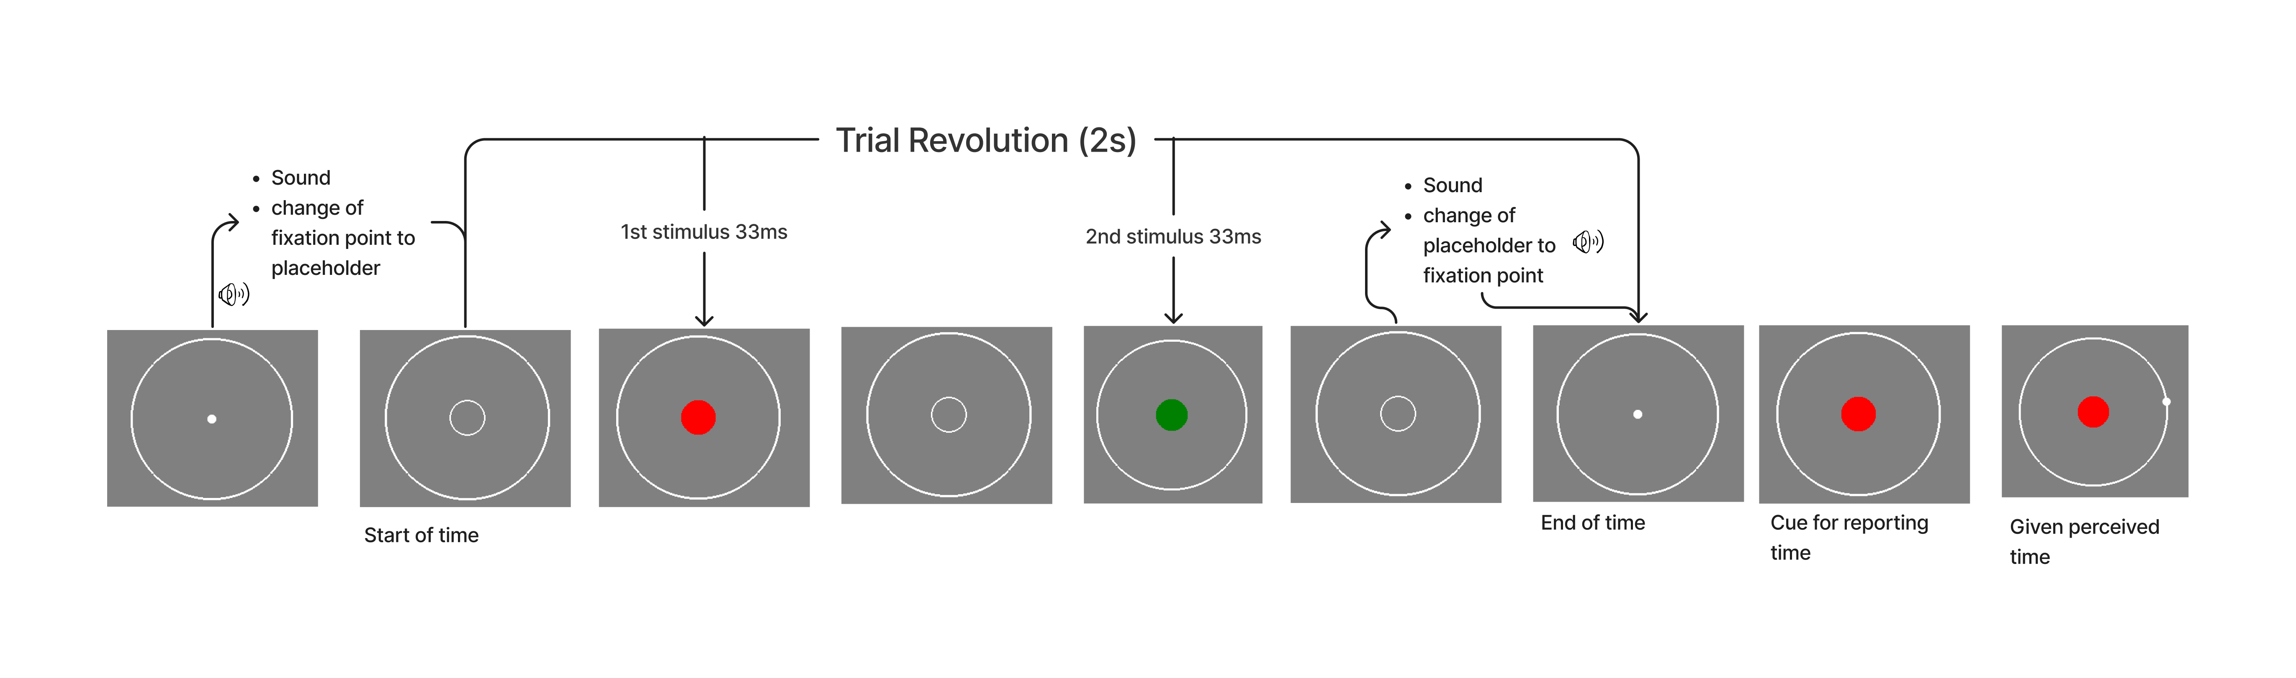
Method
Notes:
In our method, we replicated the stimuli and procedure of the Ljubica’s experiment.
In each trial, participants see a clock's circle and two different coloured disk. The disk will be presented in one of two colors: red or green.
After end of the trial, participants asked to report the time of one of the disks by clicking the appropriate position on the clock's circle.
The color of the disk you participans asked to report is indicated at the end of trial time revolution, by cue which is exactly same as the target disk's color and size.
In the baseline condition, the probability of reporting the time of the disk is equal for each color.
In the expectation condition, the probability of reporting the time of the disk is higher for one of the colors.

Slide 13
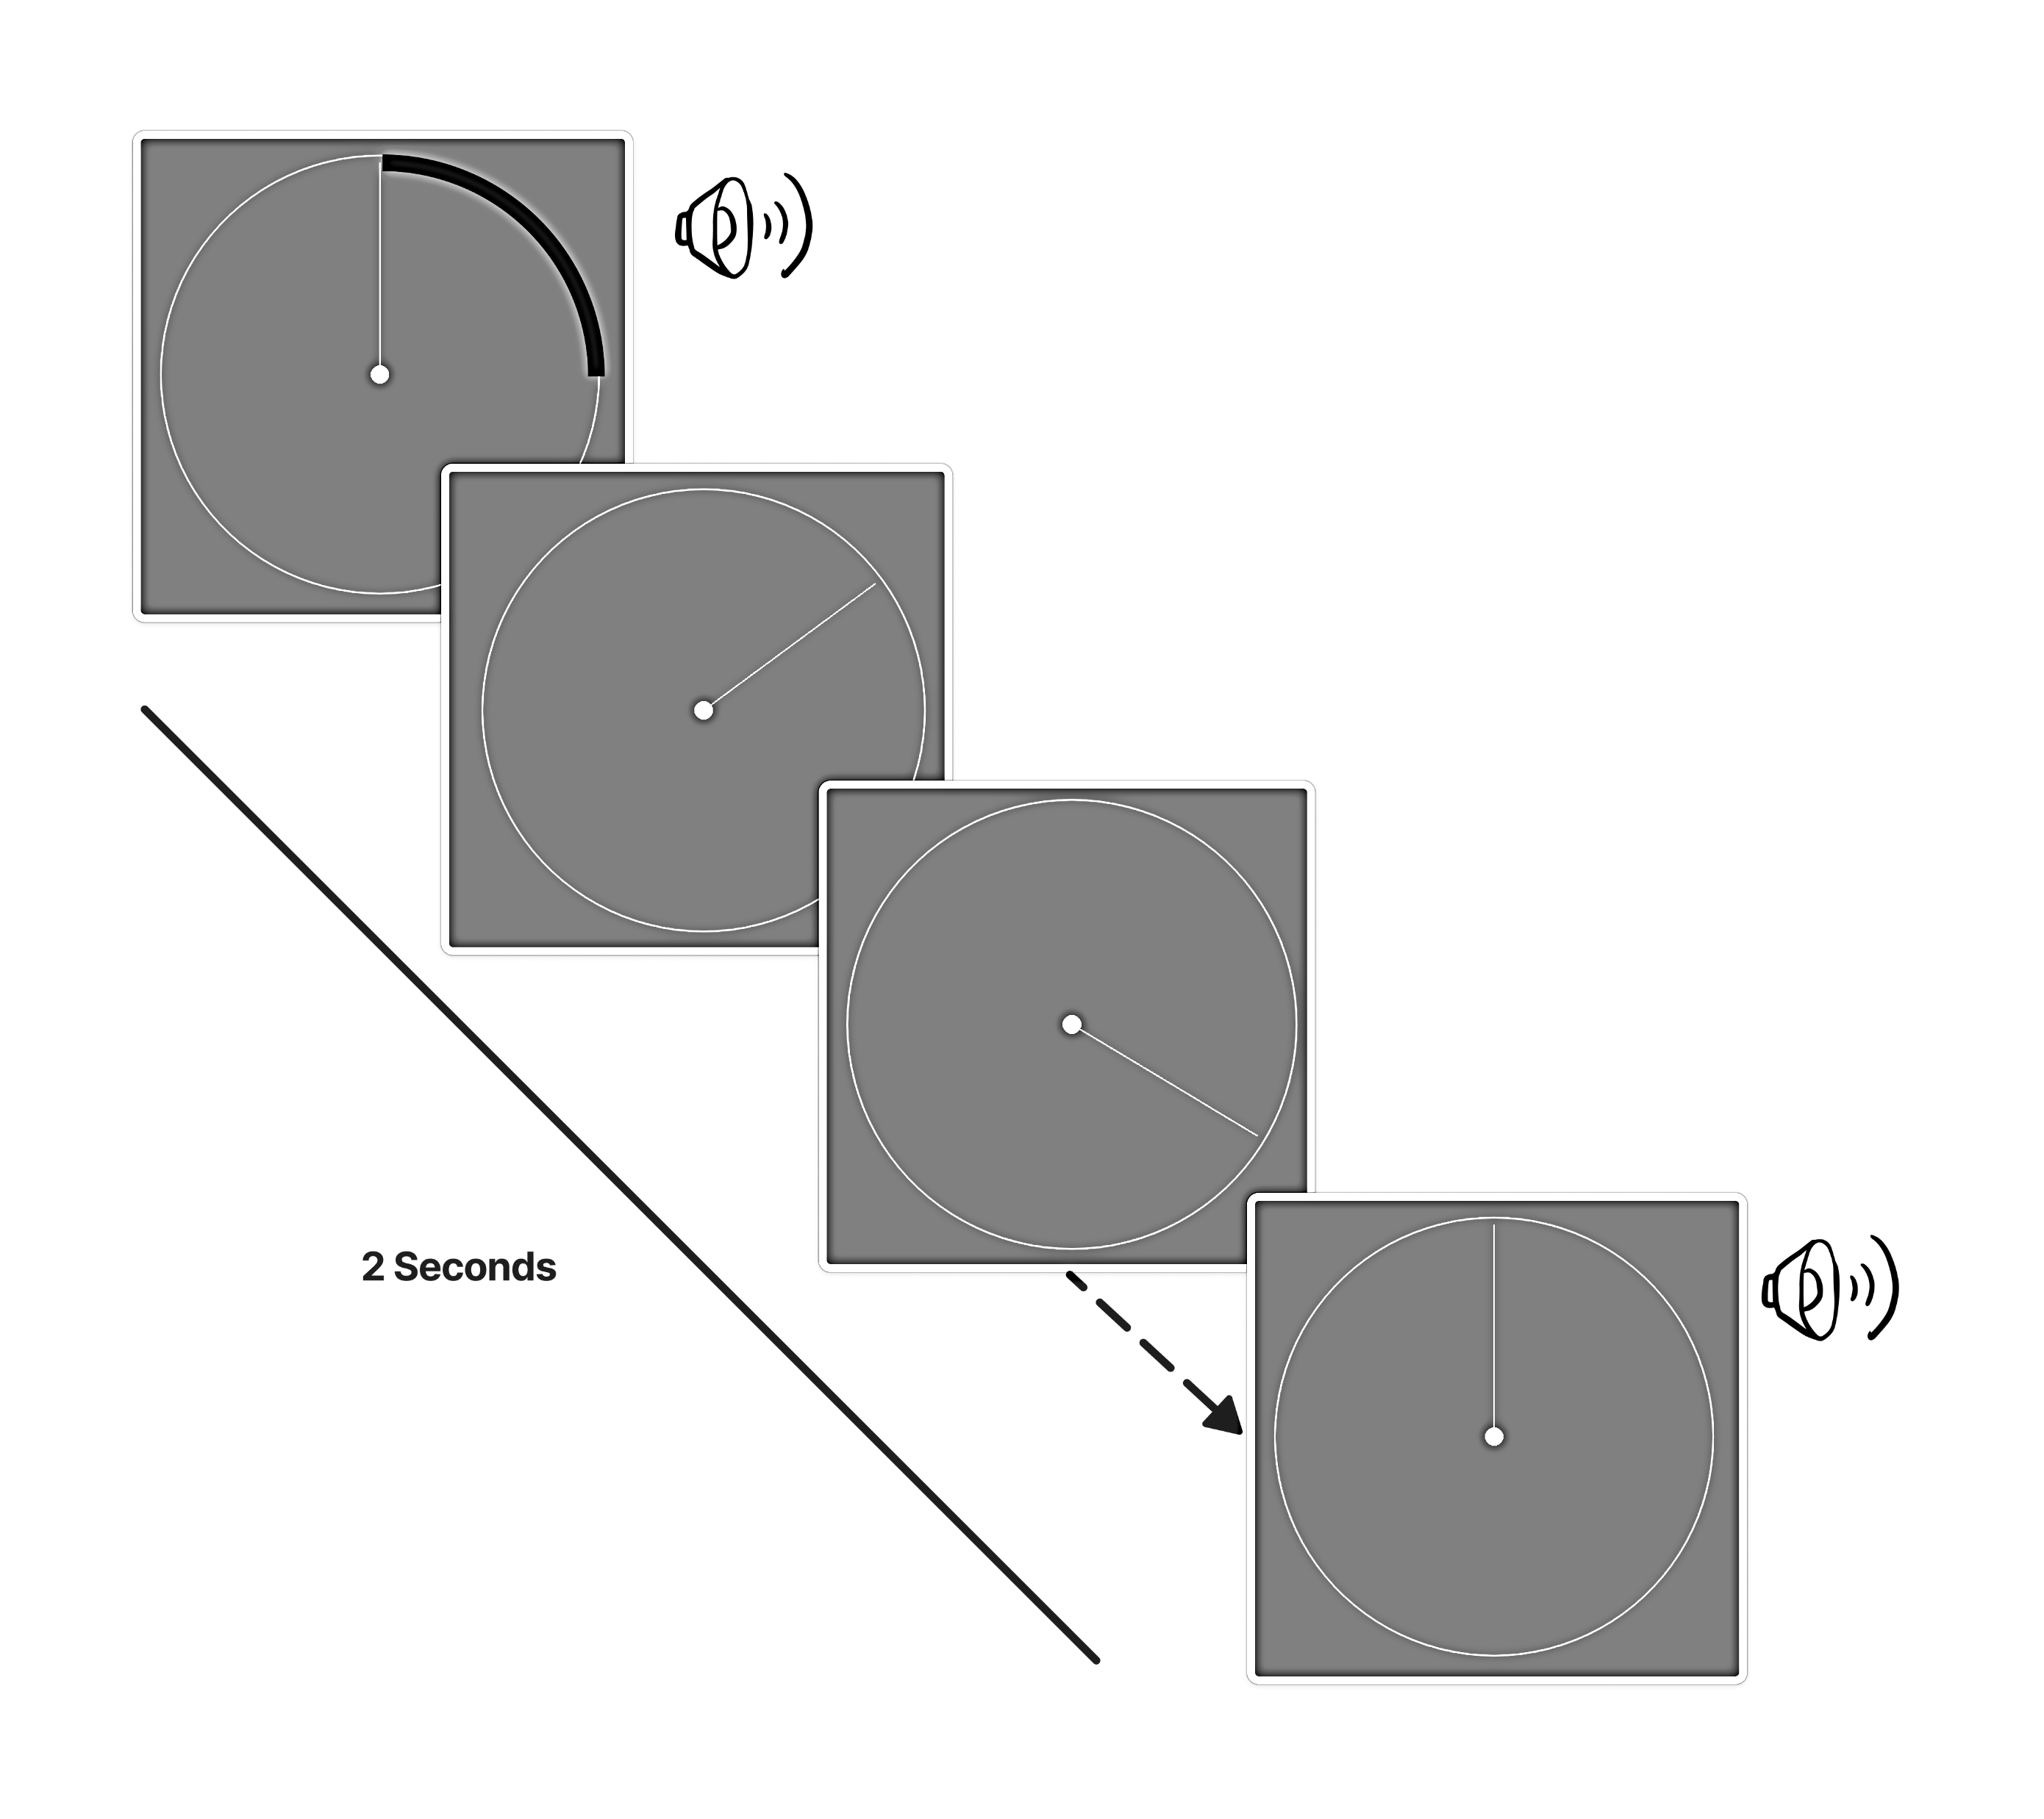
Familiarization with time
Notes:
Before the trials particpants familiarized with trial time revolution

Slide 14
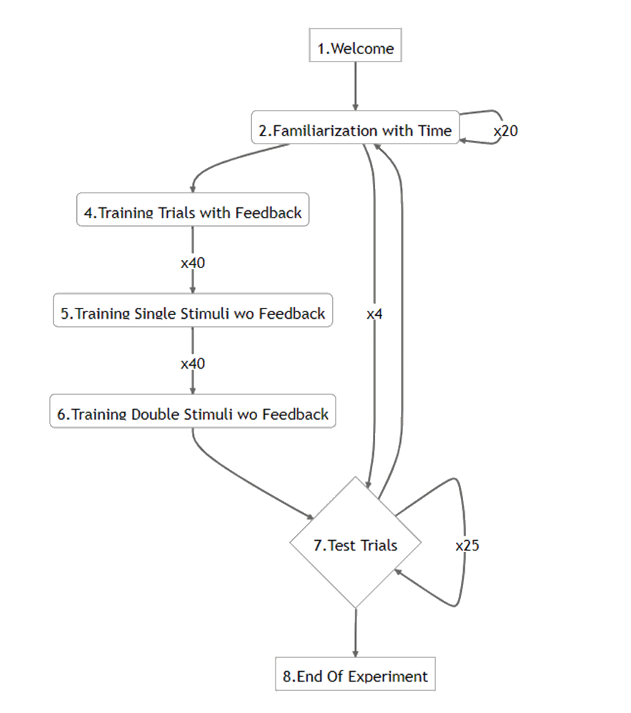
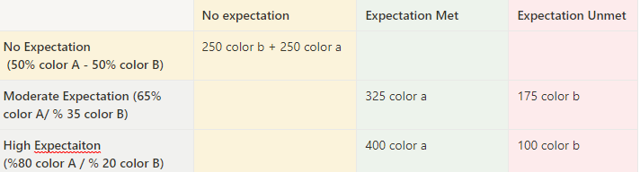
Procedure

Slide 15
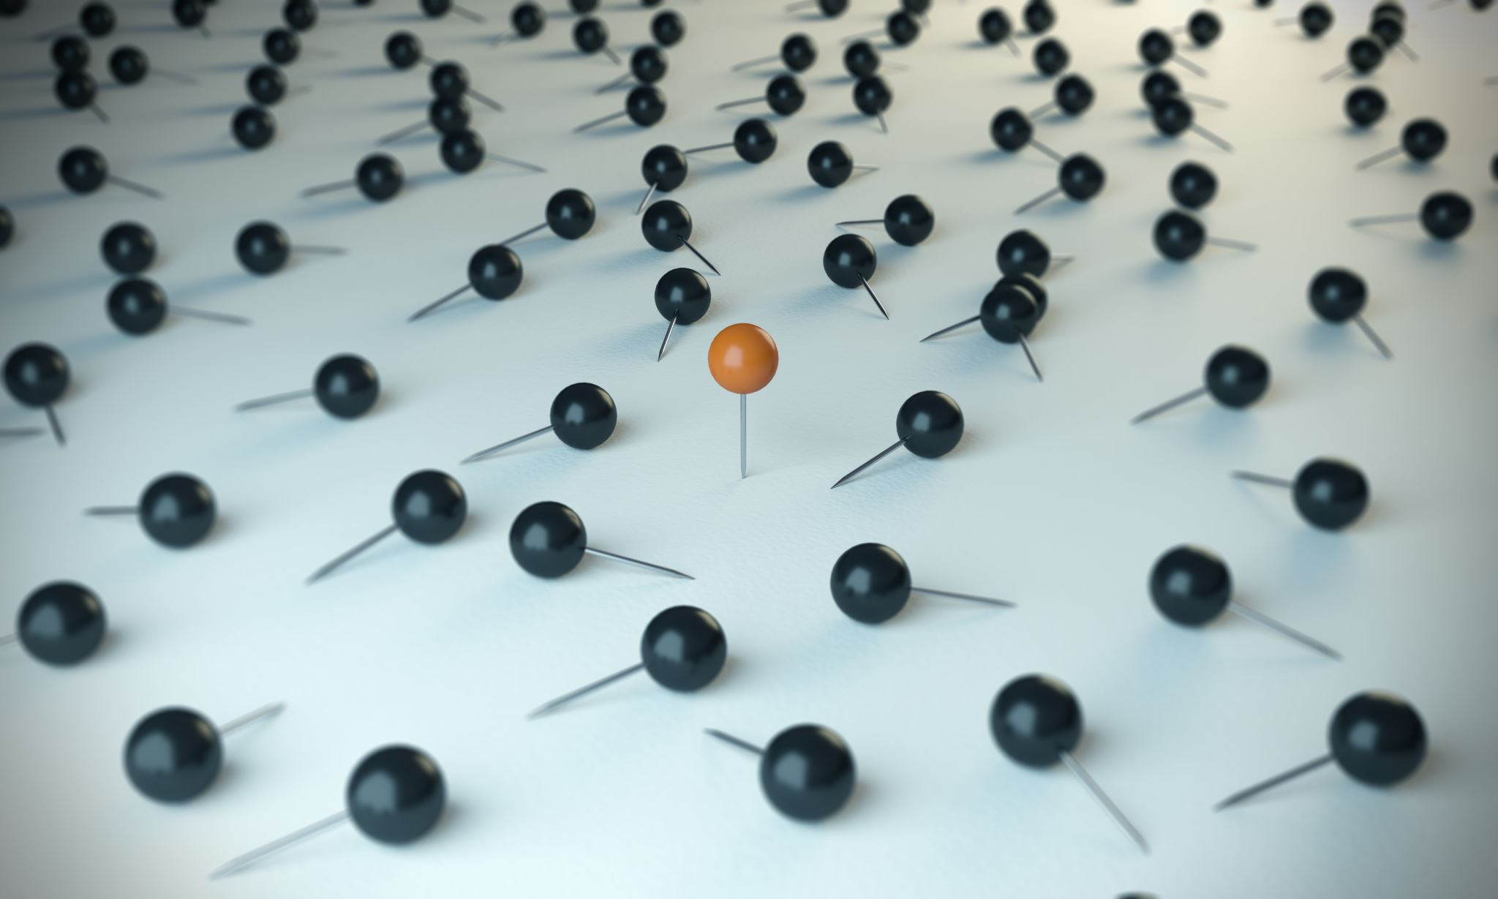
Predictions

Slide 16

Equation for Perceived Time
No expectation
If the temporal error was totally linearly effected by the distractors time:
Notes:
Based on Ljubica’s study, we created a model for our predictions.
No expectation Block
If the temporal error was totally linearly effected by the distractors time:

Slide 17
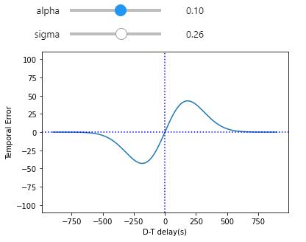

Equation for Perceived Time
No expectation
If the temporal error was totally linearly effected by the distractors time:
But it is not!
Notes:
Based on Ljubica’s study, we created a model for our predictions.
No expectation Block
If the temporal error was totally linearly effected by the distractors time:
But it is not! The effect is something similar to sinusoidal. Attraction towards distractor effect was peeking after or before certain amount of time but then if timing of distractor was too late or too early effect was likely to disappear. So its more like include a exponential function which corresponds best to the derivative of gaussian!

Slide 18

Equation for Perceived Time
3. Expected trials
The expectation would anticipate the perceived target time
However, we should also consider that expectation would decrease the interference effect of distractor
Notes:
On the other hand, at first we thought in Expected condition effect would be simillar to a precued condition, in which participants know the color of target before the trial.
So, as participants would prepare attentional resources for expected stimuli we predicted that participants would anticipate the onset time of the target and also inference of distractor would be less affective.

Slide 19

Equation for Perceived Time
3. Unexpected trials
Rather presentation order of distractor would effect the perceived temporal error in opposite directions. Either overestimate it or underestimates.
Notes:
For the unexpected trials

Slide 20
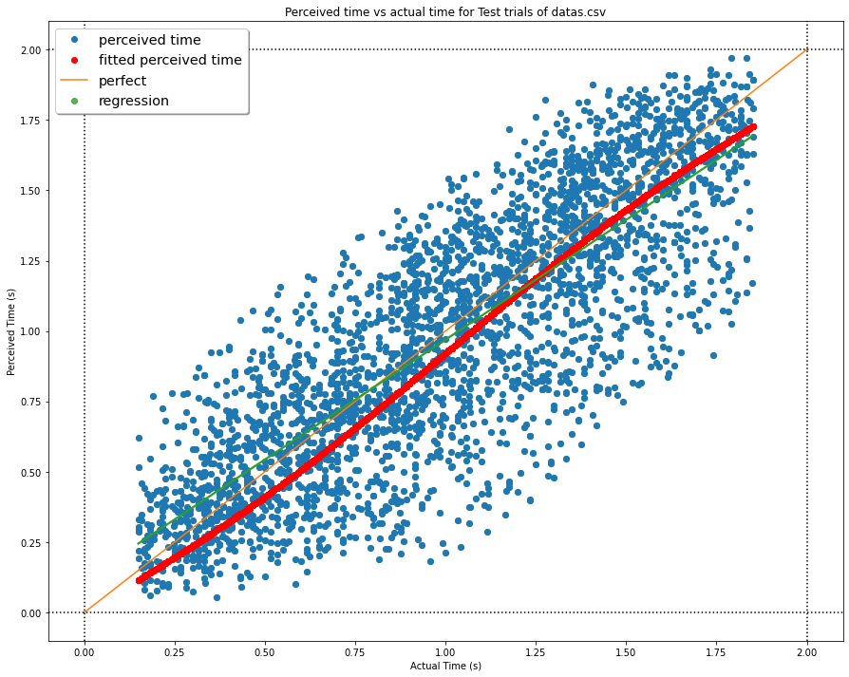
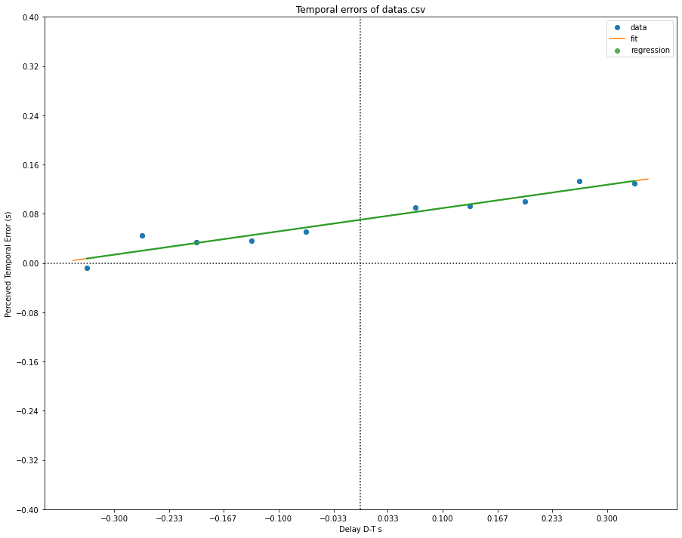
Overall Results

Slide 21
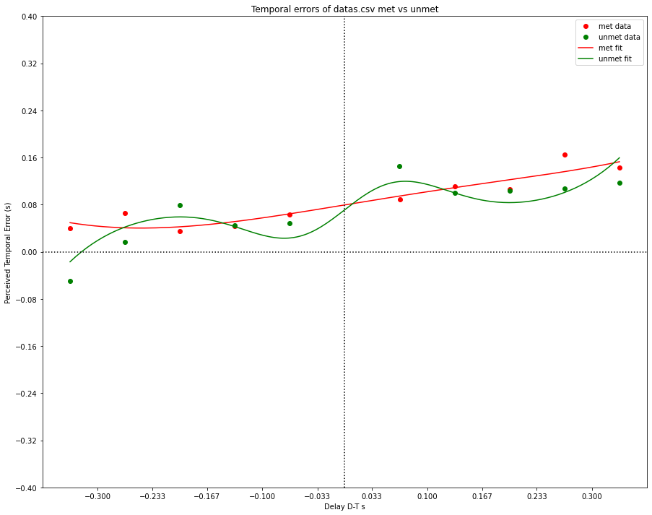
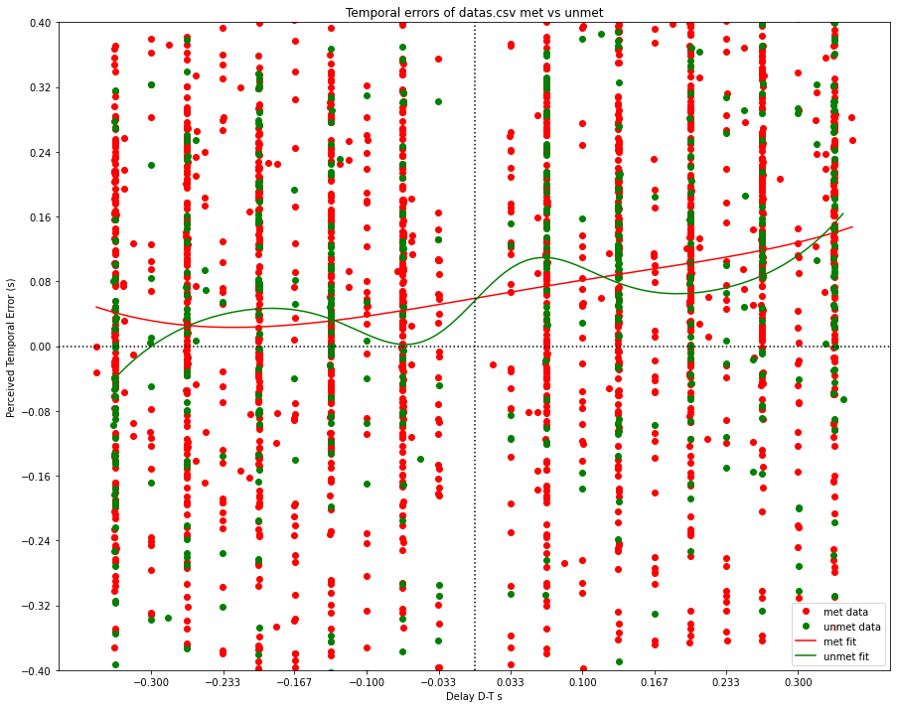

Slide 22
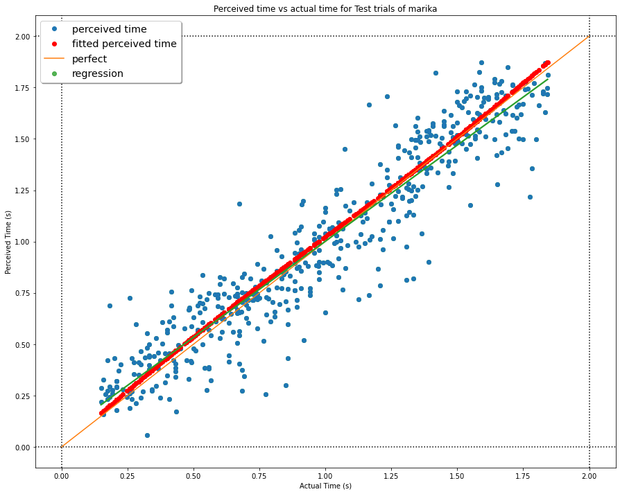
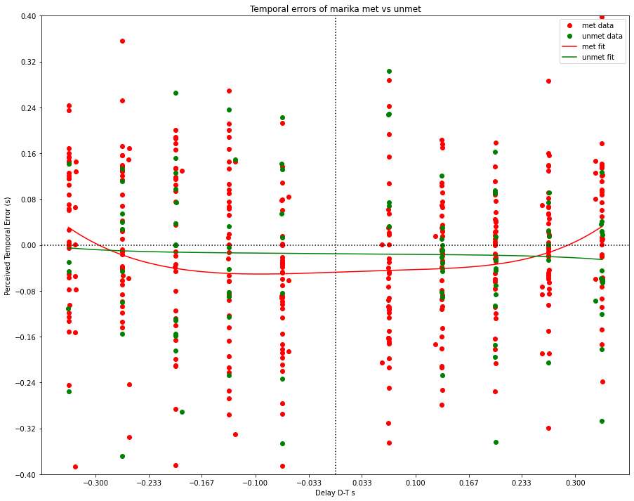
Marika

Slide 23
